Slide 1
Database Access with PHP and MySQL

Slide 2
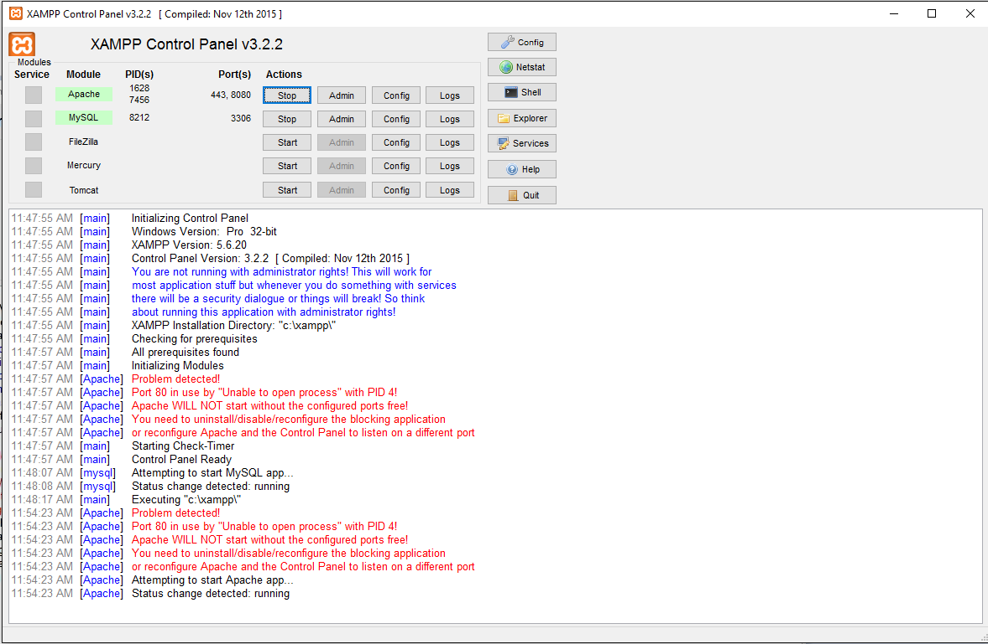
Start MySQL and Apache in XAMPP

Slide 3
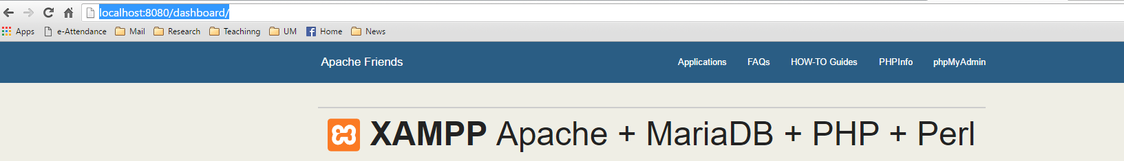
Launch Localhost in a Browser
http://localhost:8080/dashboard/
Click “phpMyAdmin”

Slide 4
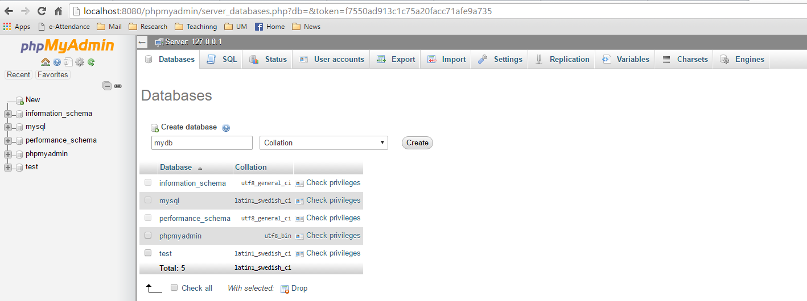
Create a Database
In Database tab, type DB name and click “create”

Slide 5
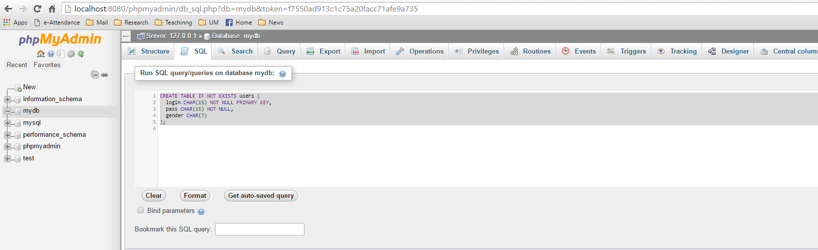
Create the Table
Choose the DB and Go to SQL Tab
Run the SQL
CREATE TABLE IF NOT EXISTS users ( login CHAR(15) NOT NULL PRIMARY KEY, pass CHAR(15) NOT
NULL, gender CHAR(7) );

Slide 6
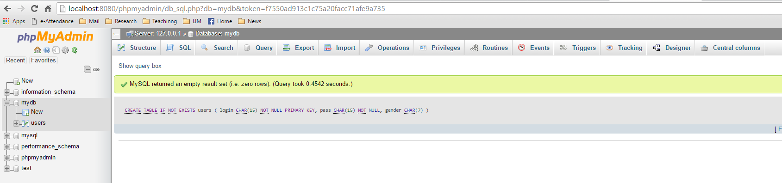
Table Created

Slide 7
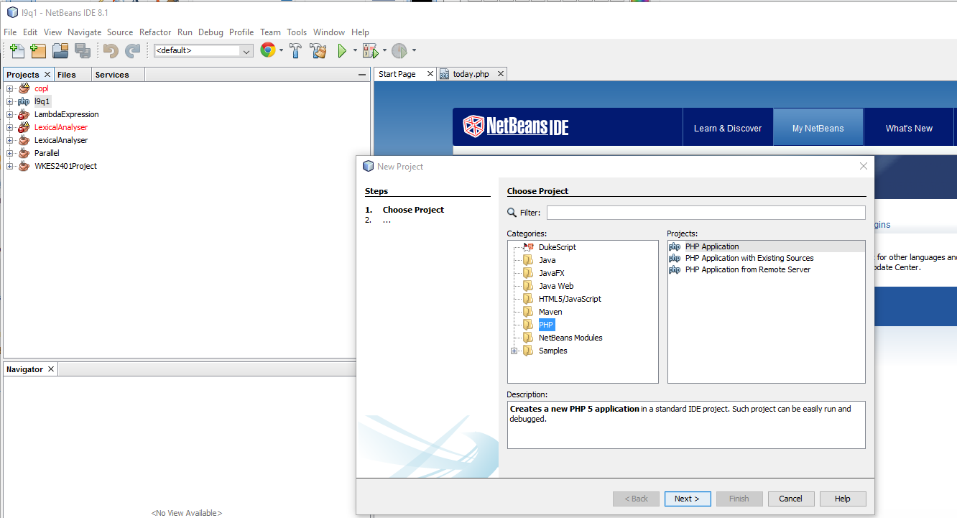
Start NetBeans and Create a PHP Project

Slide 8
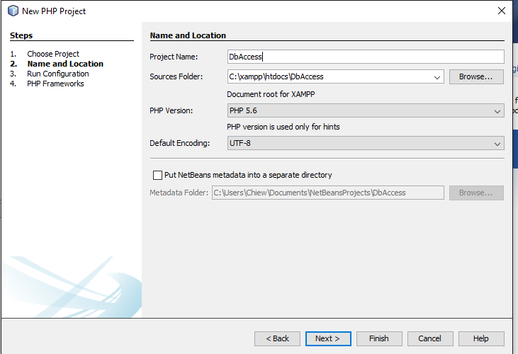
Configure the Sources Folder

Slide 9
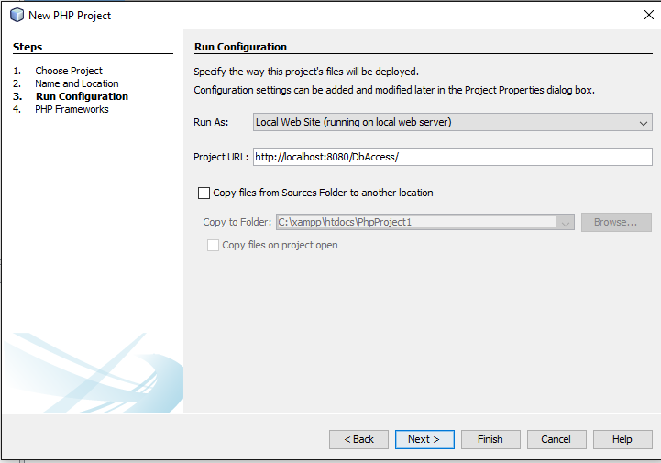
Configure Project URL

Slide 10
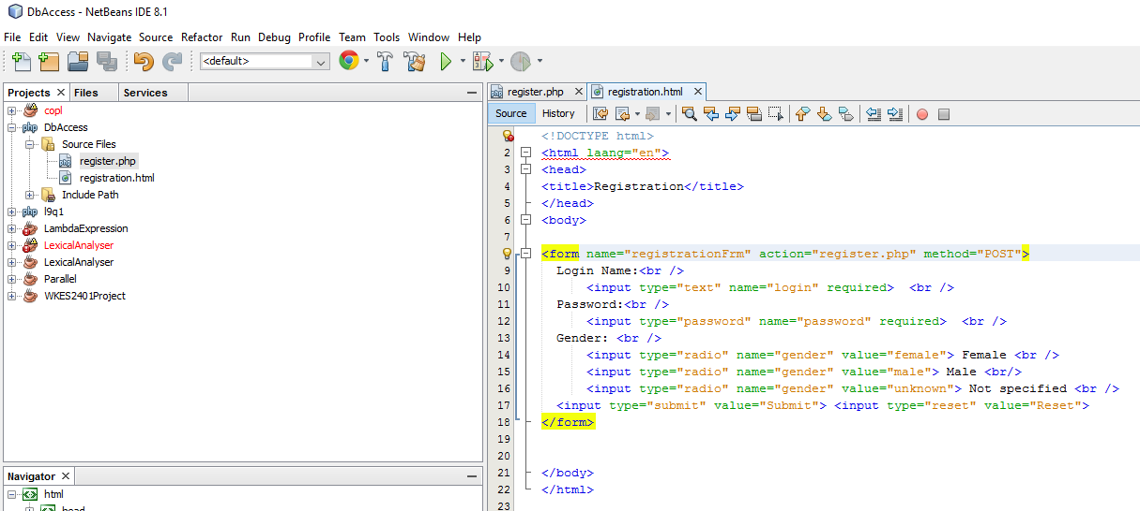
Add registration.html

Slide 11
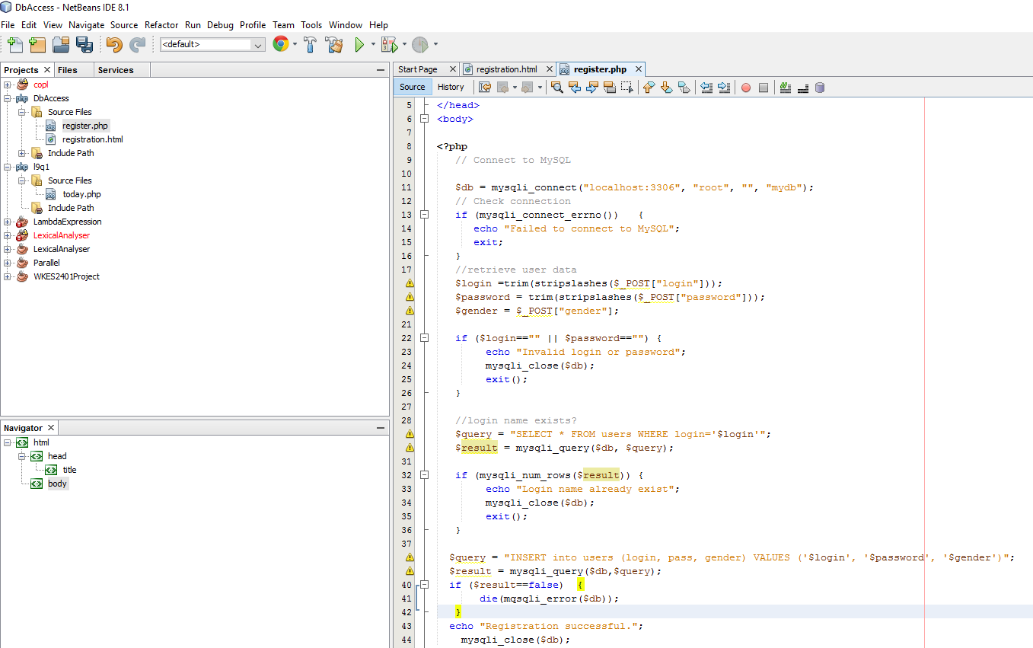
Add register.php

Slide 12
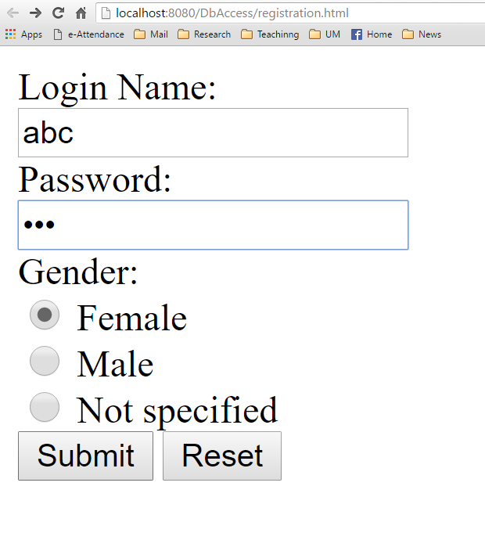
Launch registration.html and Fill In Data

Slide 13
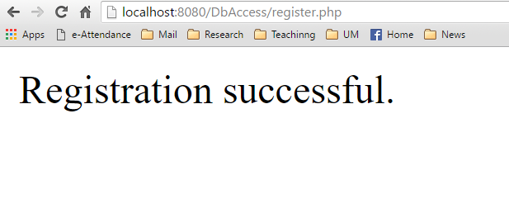
Registration Successful

Slide 14
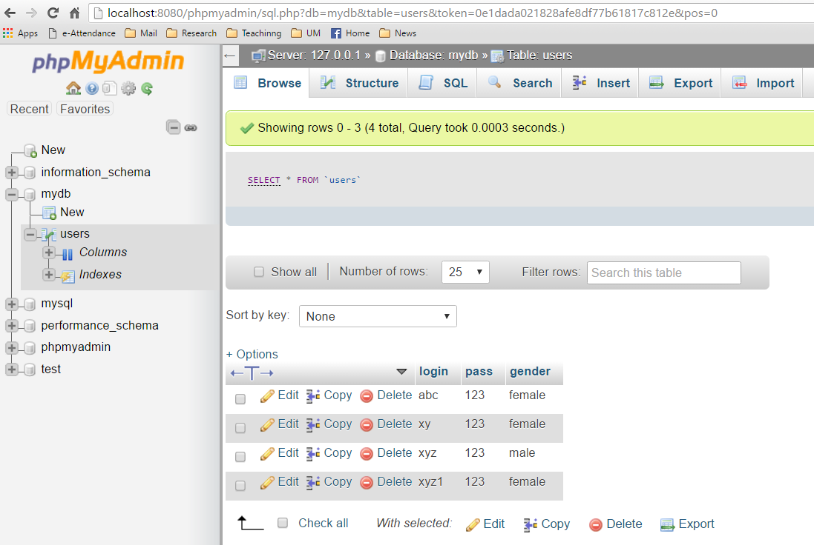
Data Inserted into Database

